Slide 1
JavaScript the Hard Parts
JavaScript principles, Callbacks & Higher Order functions, Closure, Classes/Prototypes & Asynchronicity

Slide 2
Contents
1. Principles of JavaScript
2. Callbacks & Higher order functions
3. Closure (scope and execution context)
4. Asynchronous JavaScript & the event loop
5. Classes & Prototypes (OOP)

Slide 3
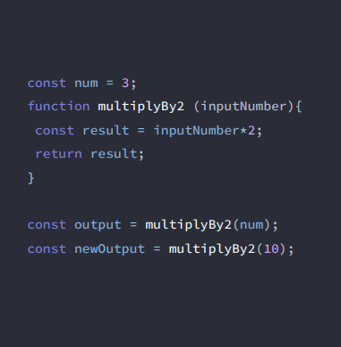
JavaScript principles
When JavaScript code runs, it:
Goes through the code line-by-line and runs/ ’executes’ each line - known as the thread of execution
Saves ‘data’ like strings and arrays so we can use that data later - in its memory

Slide 4
Execution context
Created to run the code of a function - has 2 parts (we’ve already seen them!) –
Thread of execution
Memory

Slide 5
JavaScript principles
JavaScript keeps track of what function is currently running (where’s the thread of execution)

